Slide 1
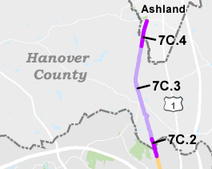
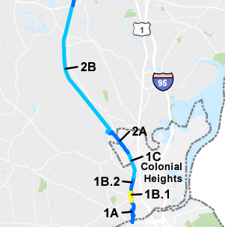
DB#1 – Northern Section
Status
Advertised: Dec. 2022
Awarded: April 2023
Holly Hill Rd to Walder Ln
Henrico County
DB#2 – Southern Section
Status
Alignment (more discussion to follow)
Environmental concerns(more discussion to follow)
RFP Advertisement Goal: May 2024
Patton Park to W Hundred Rd
Chesterfield County

Slide 2
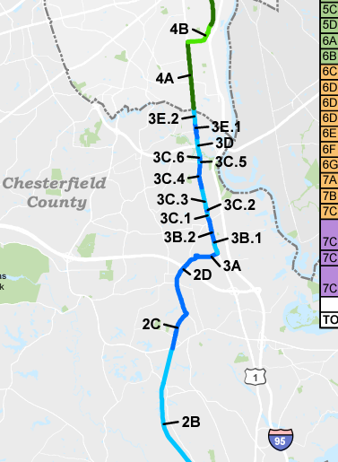
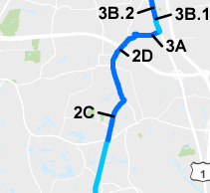
DB#3 – Southern Section
Segments
2C – W Hundred Rd to Chester Rd
2D – Chester Rd to Galena Ave
3A – Galena Ave to Galena Ave/US 1
3B – Galena Ave/US 1 to US 1/CSX RR Bridge
Includes UPC 118146 – Galena Ave/US 1 to Willis Rd
3C – US 1 / CSX Bridge to Falling Creek
3D – Falling Creek to Food Lion Parking lot
3E – Falling Creek to Food Lion

Slide 3
DB#3 – Southern Section
Status
VDOT to begin coordination of SPA this summer
RFP approximately 6-9 months after DB#2 advertisement

Slide 4
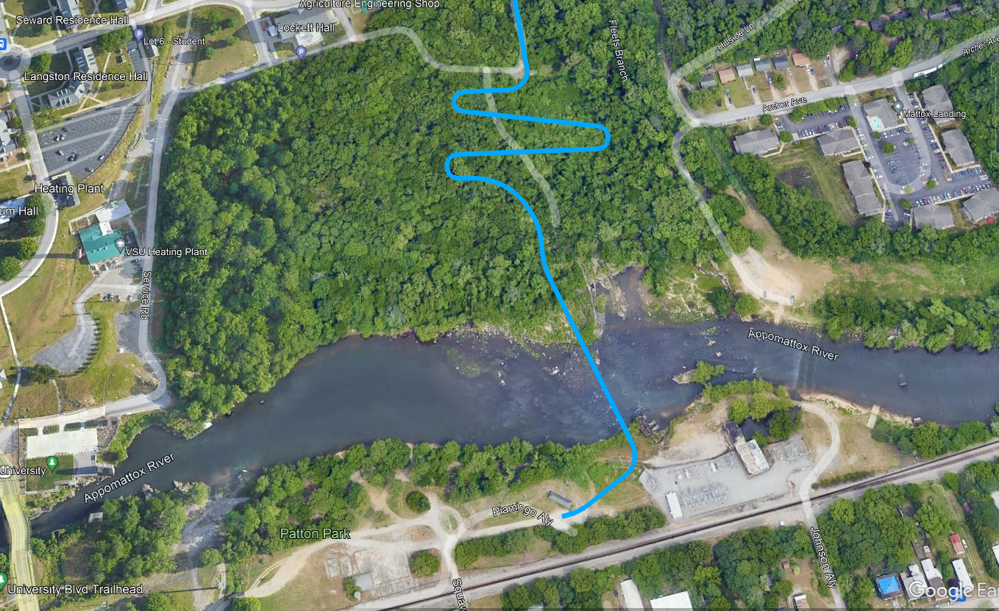
DB#2 – Southern Section – Appomattox River Crossing Cultural Resources Concerns
Originally Proposed Alignment

Slide 5
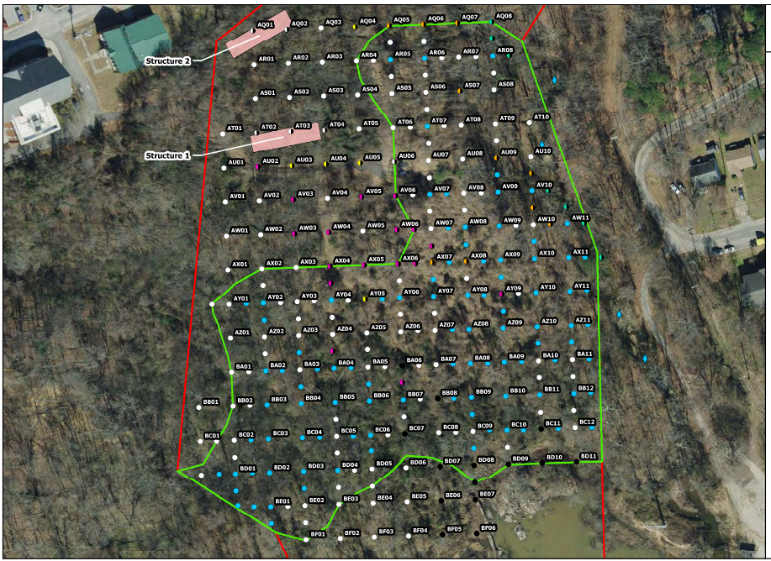
VSU Alignment – Cultural Resources Concerns
Switchback needed due to steep grade
Surveys identified a large archeological site within the project corridor.
Every Blue Dot indicates a positive location for artifacts
Exploring avoidance alternatives to minimize any adverse effects on this archeology site.

Slide 6
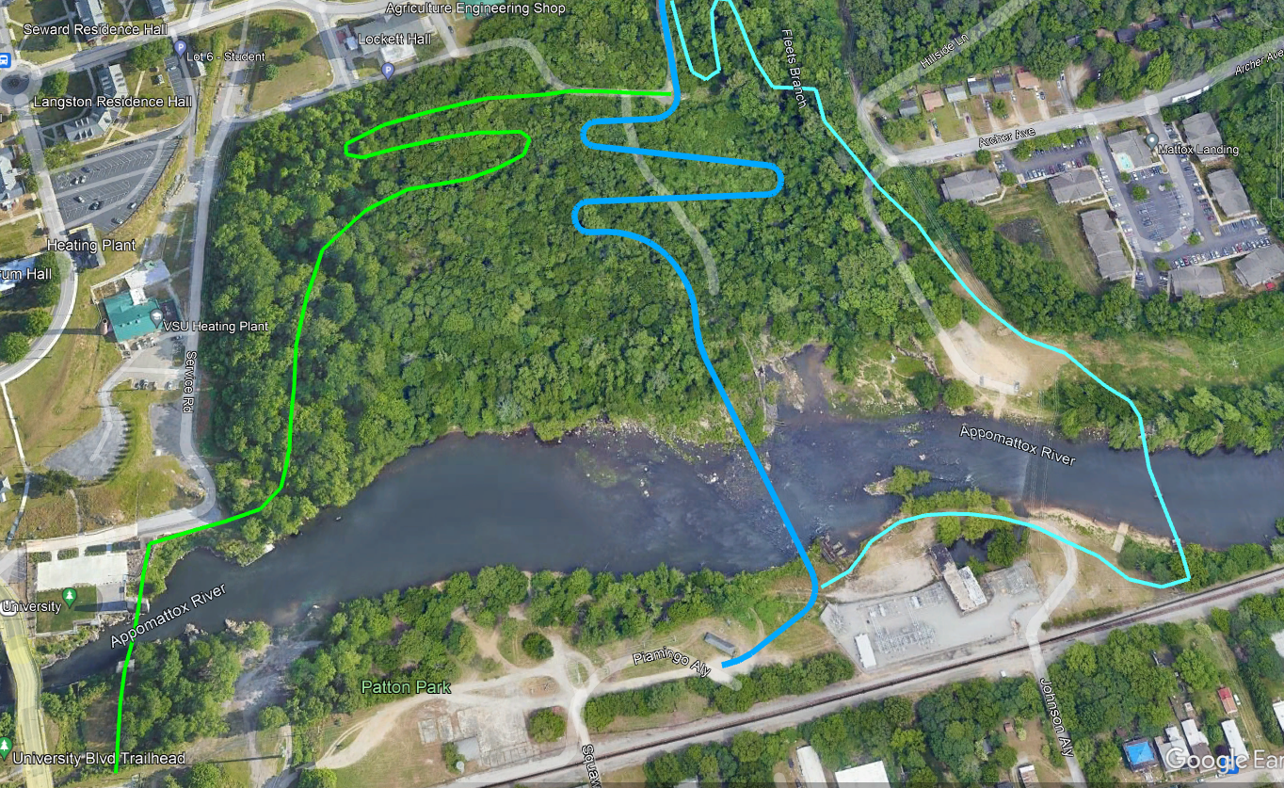
VSU Alignment – Possible Avoidance Alternatives

Slide 7
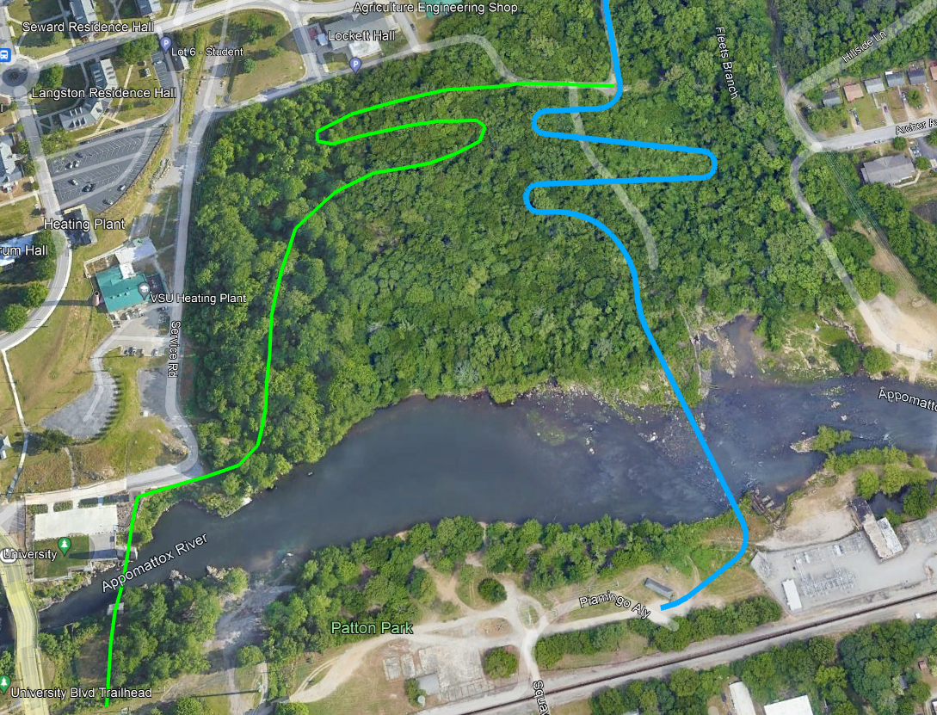
VSU Alignment – Green Alignment (Pros/Cons)
Pros -
Re-purpose historic train trestle piers
Relatively short spans across the Appomattox (90')
Original Plan was to start the FLT here
Reduced number of property owners
2-span bridge
Avoids VOF easement property
Cons -
Significant archeological resources on the southern bank of the Appomattox River in this location
Protection of archeology site raises serious constructability concerns
Additional cost for wetland impacts
Use of these historic piers could be a costly engineering challenge due to construction style

Slide 8
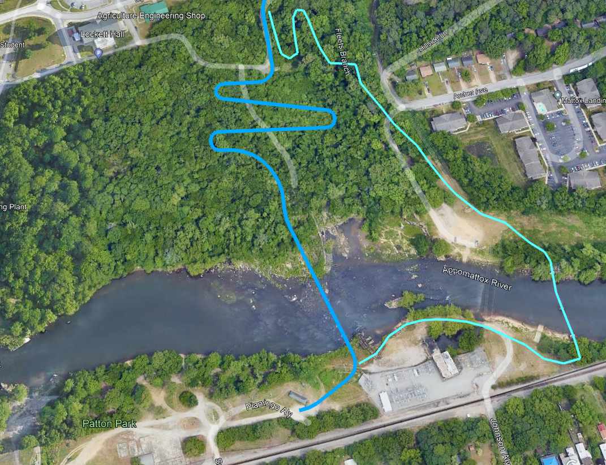
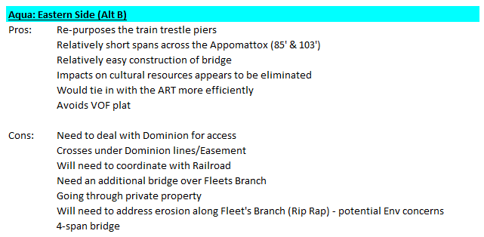
VSU Alignment – Aqua Alignment (Pros/Cons)
Pros -
Re-purpose historic train trestle piers
Piers appear to be in great shape
Relatively easy engineering for bridge
Relatively short spans across the Appomattox (85' and 103')
Impacts to Cultural Resources greatly reduced
Will tie in to ART more efficiently
Avoids VOF plat
Significant portion of this alignment is already in public right of way
Cons -
Dealing with Dominion for access to their small portion of the alignment
Coordination with the railroad
Likely to require additional bridge over Fleets Branch

Slide 9
Appomattox Crossing Alignment – Next Steps
Goal is to stay on schedule for completing NEPA document
Environmental Study Area has been expanded to encompass both new alternatives
Cultural resources and Wetland Field Surveys on the new locations are already underway
Development of a conceptual bridge design to present to VDHR is underway
VSU is open to discussing potential alignment shifts

